Slide 1

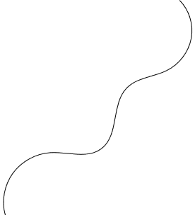


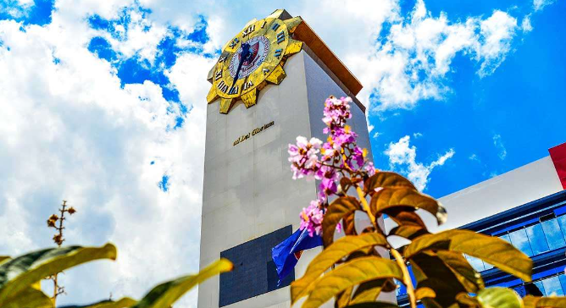

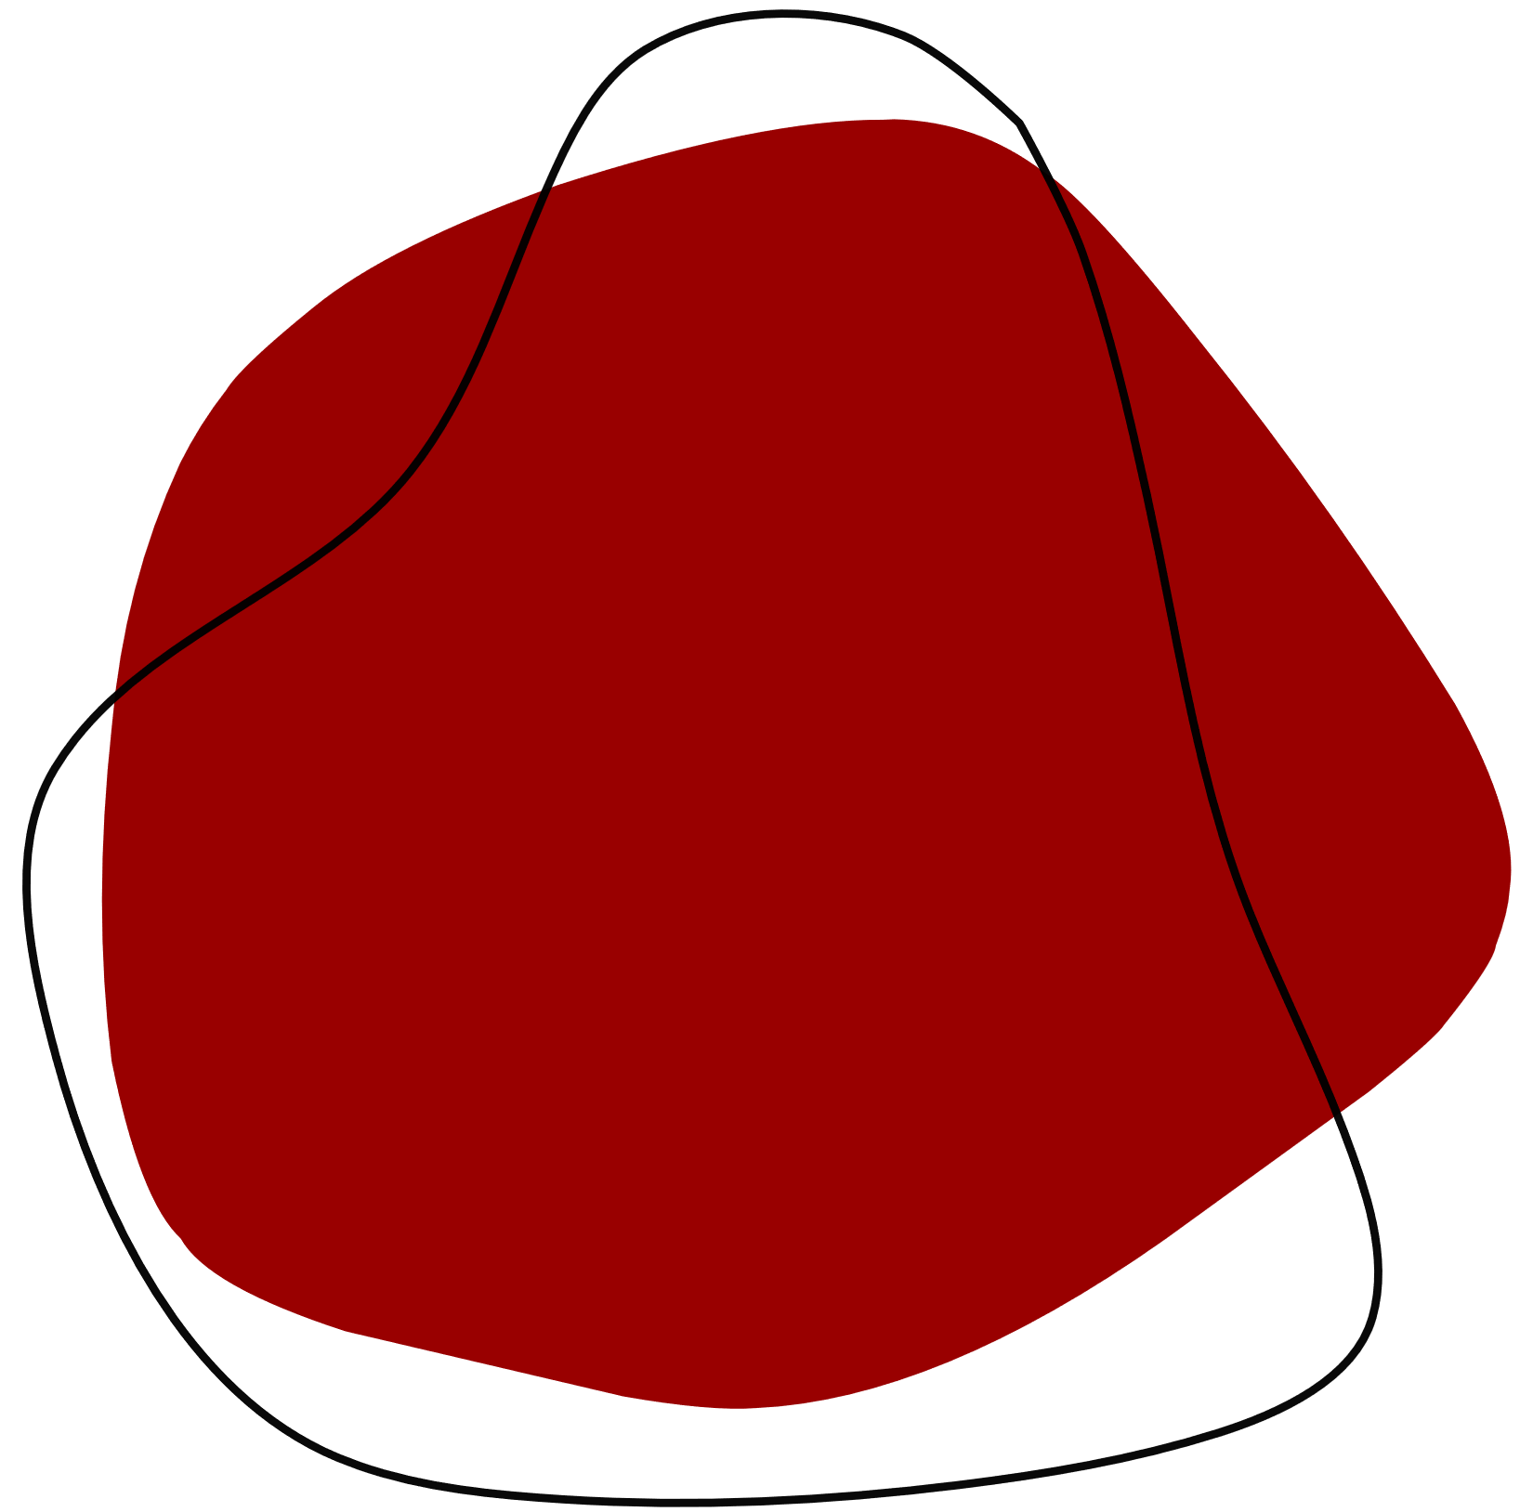
AquaGuard:
Integrated Cloud-Monitoring System for Proactive Fish Kill Prevention Utilizing
IoT-Based Dissolved Oxygen and Contamination Level Sensors
30 April 2024

Slide 2


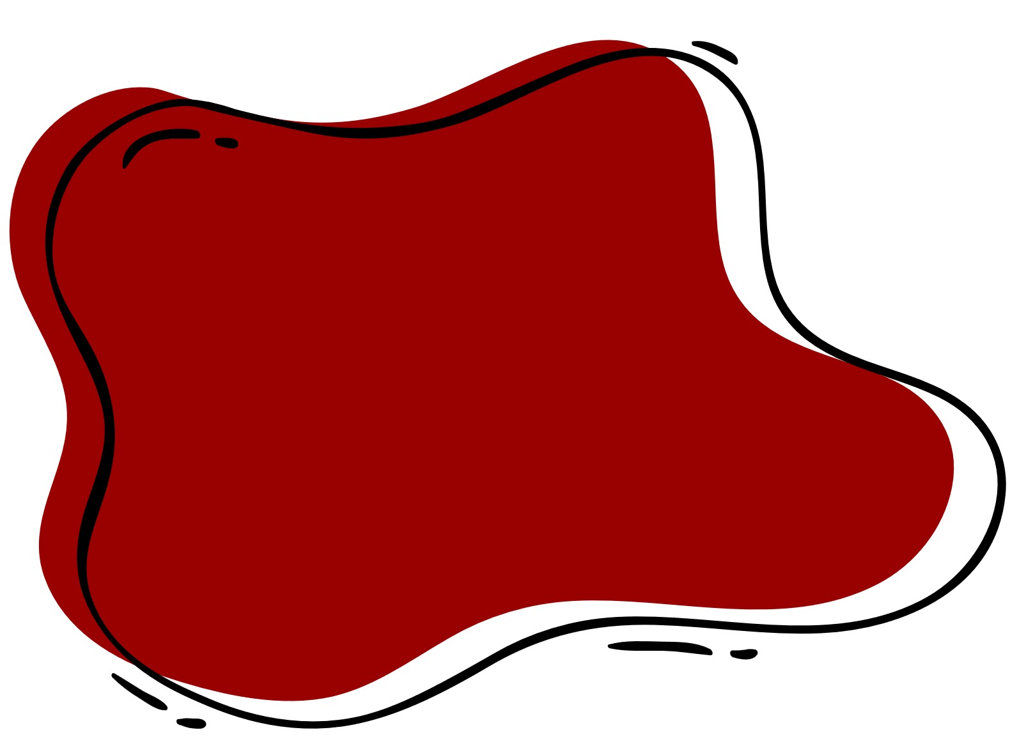
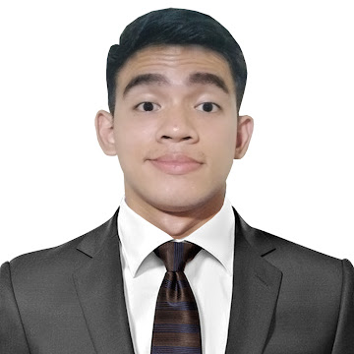
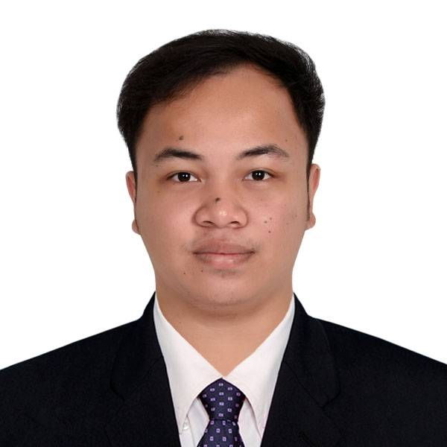
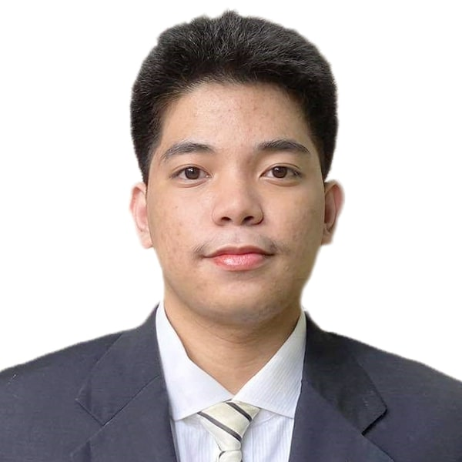
Alinsunurin, Aleister
Laylo,
Julius Melwin D.
Ramos, Allen Eidrian S.
BSIT-NT
BSIT-NT
BSIT-NT
THE PROPONENTS
Ryndel Amorado
Adviser

Slide 3
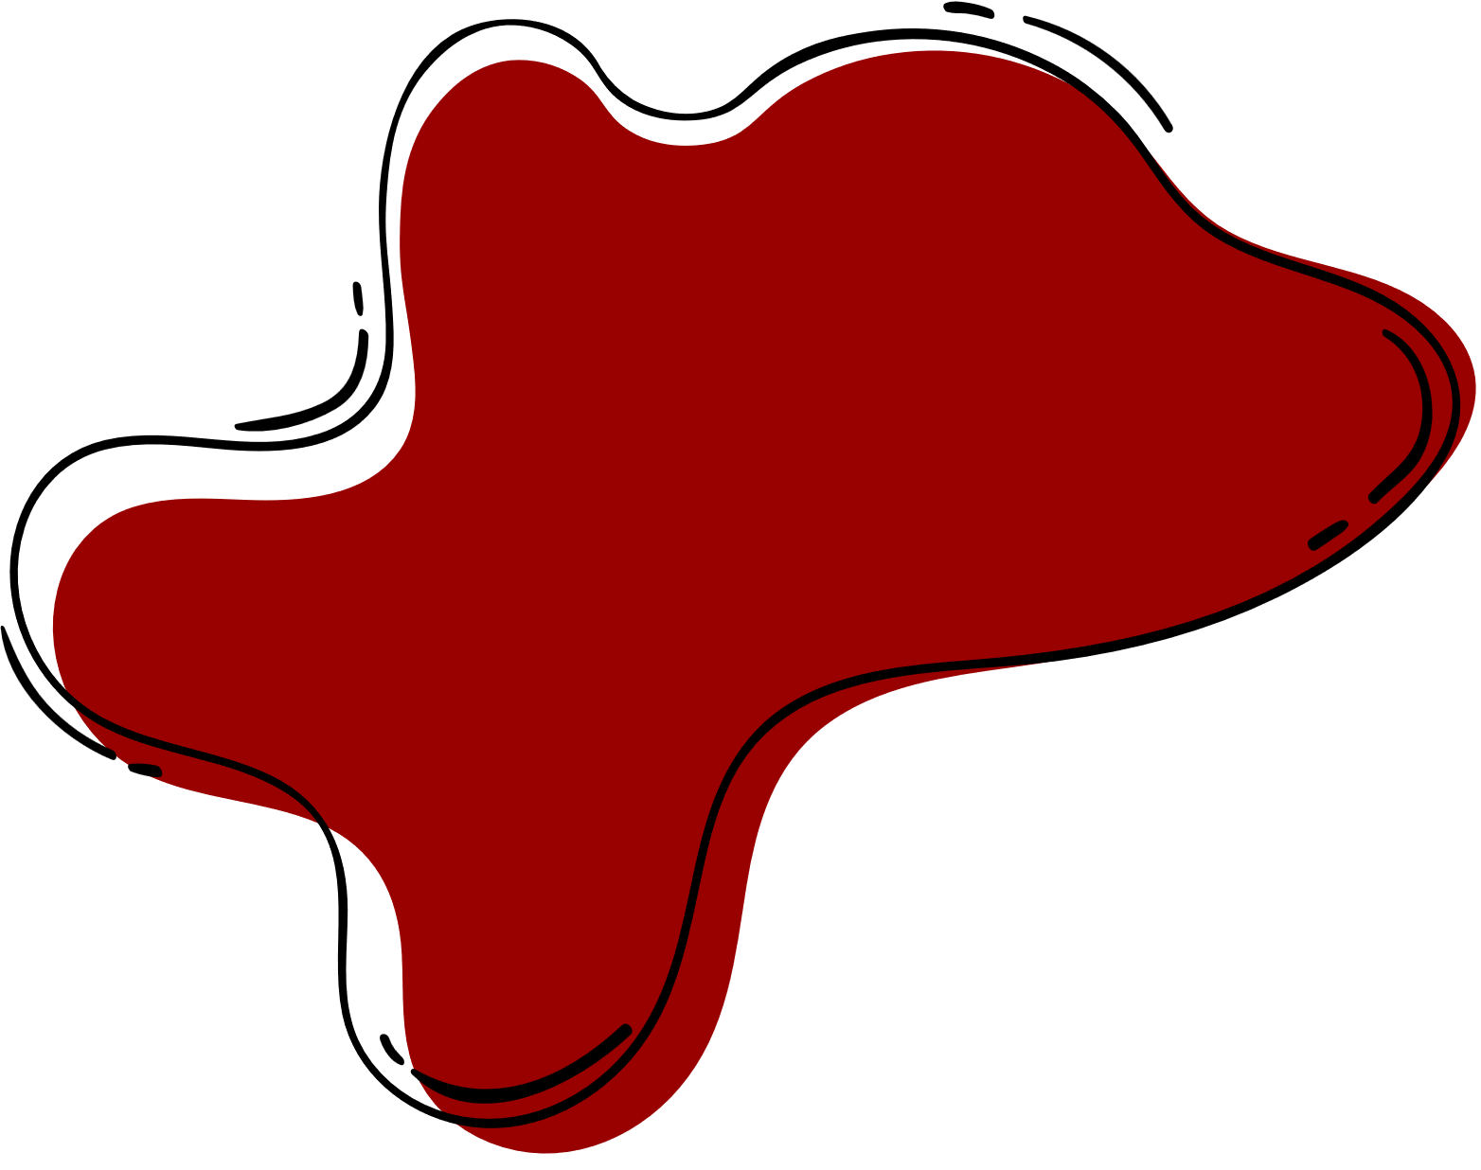
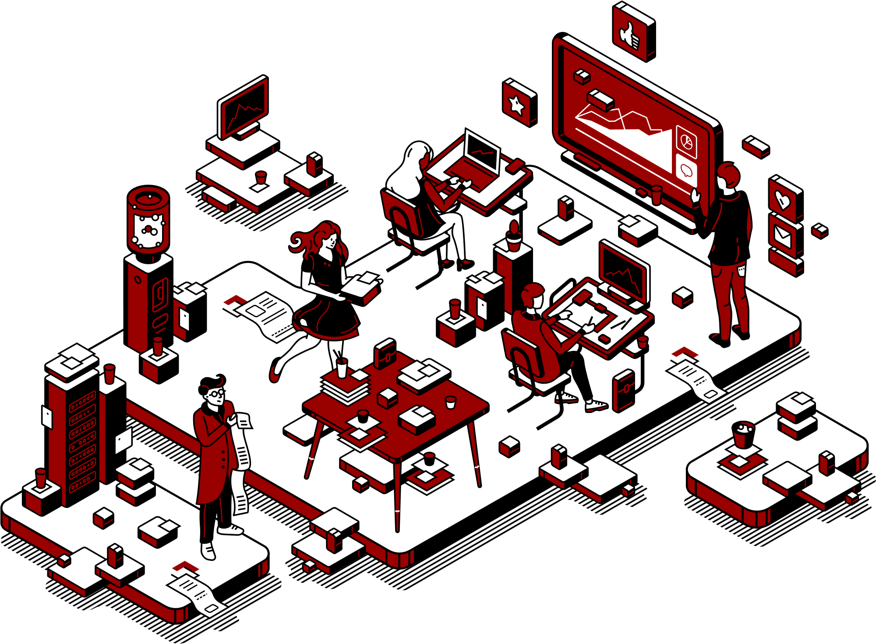
Project Context
With numerous fish kills happening in the taal lake, different businesses suffer millions of pesos as losses because of severe water quality of the lake.
Thus, the proponents proposed a water quality monitoring system that will help detect water quality and then improve its quality with Anjo Fish Farm as it’s stakeholder.
Researchers highlight the limitations of traditional onsite measurements and stress the importance of continuous monitoring for timely detection, aligning seamlessly with the capstone project's objectives according to the study of Xiaodi et al. (2020)

Slide 4
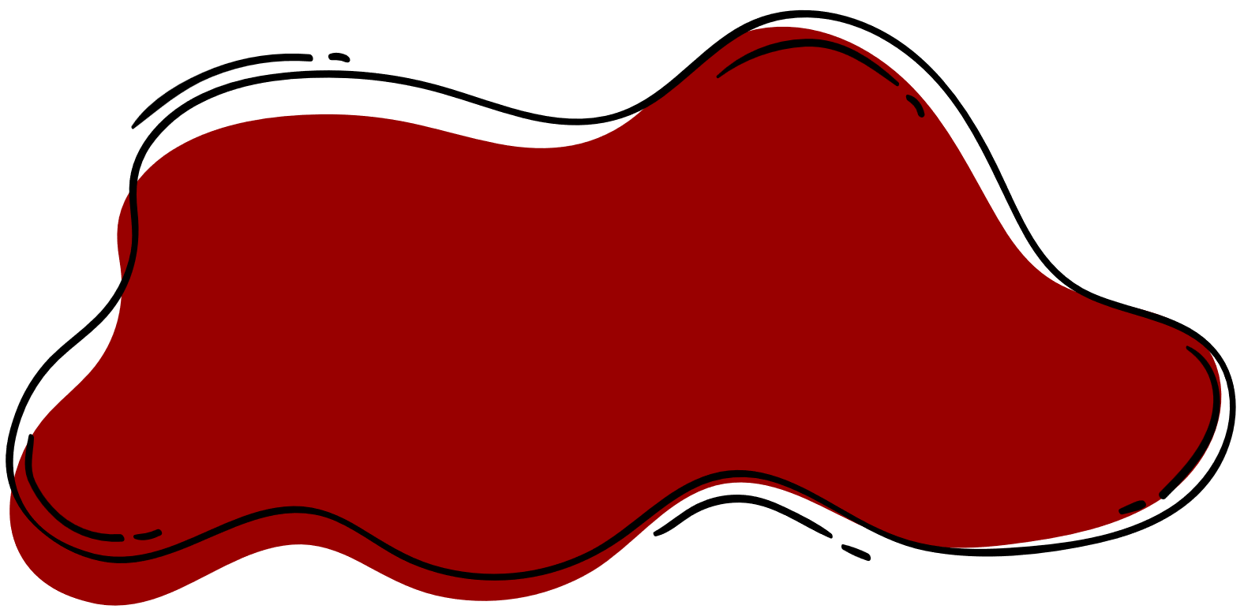
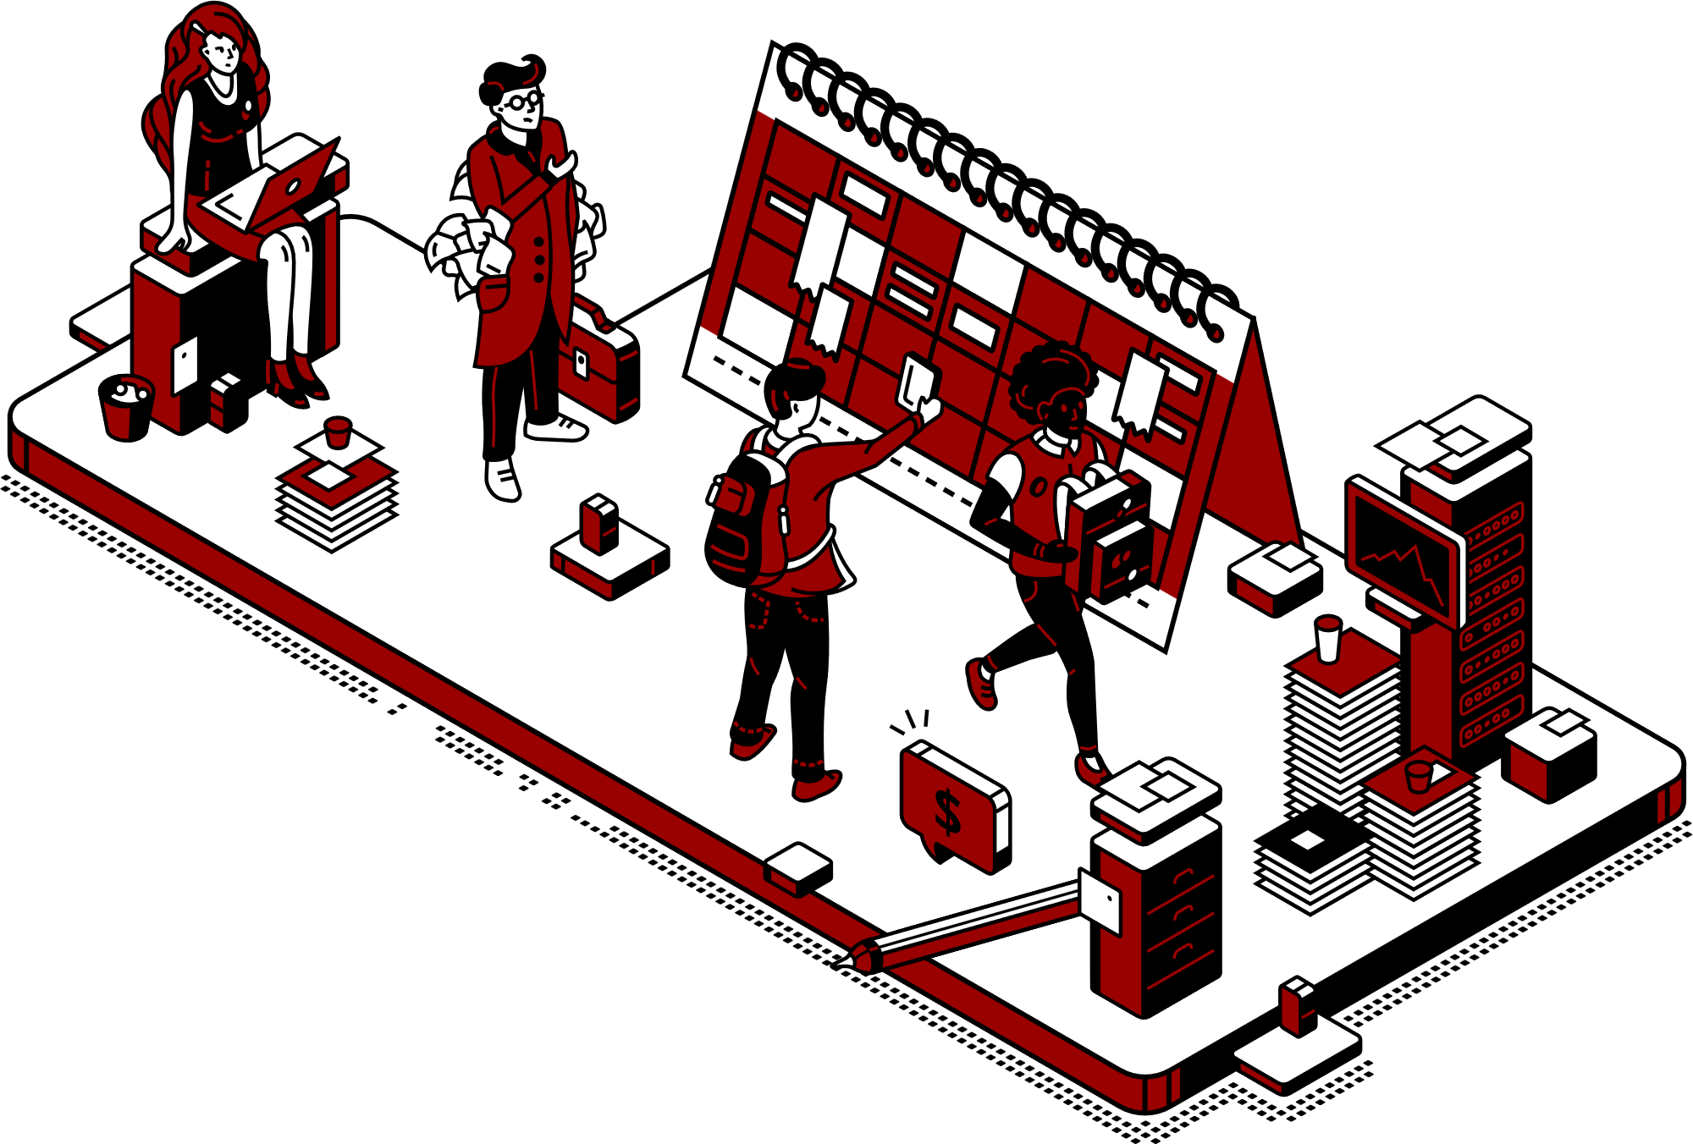
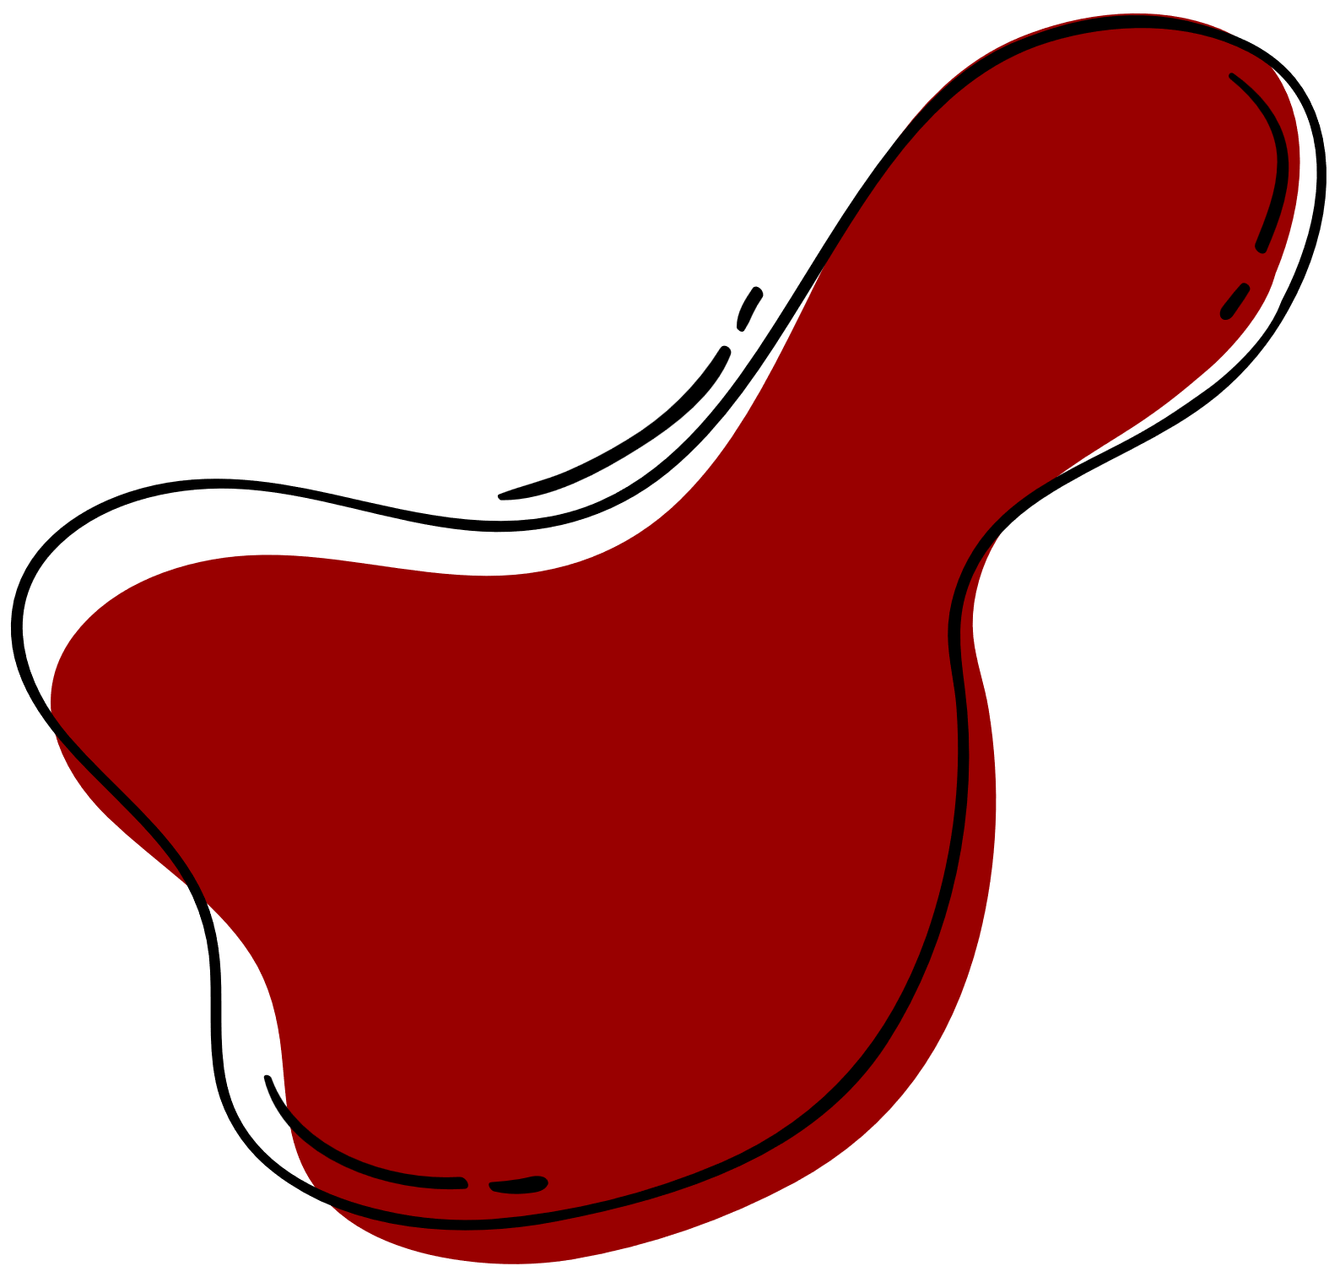
Purpose and Description
With different human-made activities mainly aquaculture processes, the lake has been severely polluted.
The main purpose of the study is to monitor the water quality of the Taal lake in order for it to be improved drastically.
The study also aims to lessen fish kill attacks by the use of proper water quality management
Lastly the study aims to lessen the effects of aquaculture processes using advanced, technology-driven solution for sustainable aquaculture practices.

Slide 5





Objectives
The main objective of this project is to create an integrated system that can monitor water quality in real-time. This system will use IoT devices, sensors, and cloud integration.
Objective 1: Develop an integrated cloud-monitoring system for real-time water quality analysis
Objective 2: Improve decision-making and data management for sustainable fish farm practices
Objectives 3: Implement proactive alerts and strategies for optimal maintenance of water quality

Slide 6

Scope
Scope
Scope and Limitations
Monitor the water quality of the Fish Farm located at Taal Lake
SMS alert system implementation based on Sensor Data.
Limitation
Limitation
Remote location of the Devices, limits the connection capabilities.
The device is limited to only four core water quality sensors.

Slide 7
Technical Background
Using an integrated features of Cloud, Web-system and IoT devices requires a lot of major technical concepts and methodologies:
Hardware Devices
Arduino UNO
LoRaWAN & Antenna
Water Quality Sensors: pH, Dissolved Oxygen, Nitrate & Temperature
Buoy Prototype
Software Requirements
Web-system: HTML, CSS JavaScript MySQL and PHP
Arduino Programming: C++
Azure Cloud Services

Slide 8
Related Literature
Cloud Services - Cloud computing is a new concept that aims to manage, utilize, and harness various hardware, software, and firmware resources through network connectivity. The concept offers two major advantages: users can choose from a wide range of resources, including hardware, operating systems, software, firmware, middleware, platforms, and more. (Barua., 2021).
Machine Learning - The integration of IoT and AI in aquaculture has the potential to improve usual productiveness, decrease cost-intensive amounts of labor, and enhance efficiency. Deep learning (DL) improves records preprocessing and statistical tools for smart fish farming. By getting complex facts in past data analysis, deep learning improves data pretreatment without human parameter
adjustment (Chiu et al., 2020).

Slide 9
Related Literature
IoT Devices - Additionally, IoT-based solutions lessens the expenses in both time and money for addressing water crisis, more importantly fish kills where the clean water is limited. Thus, through the development of affordable IoT prototypes, cities and businesses can mitigate the adverse effects to water pollution and ensure a healthier future for all (Munir et al., 2018).
Taal Lake Quality - One of the leading cause of pollution is the uncontrolled processes of businesses in Taal Lake, the overstocking of fish and the waste of uneaten fees led to a domino effect - a phenomenon known as eutrophication. This scenario is not all about ecological devastation but also
represents the big economic blow to the local fishing communities from small to large businesses who depend on the lake for their everyday livelihood (Mendoza et al., 2019).

Slide 10
Related Literature
Web Development - Nugroho et al. (2017) developed a Monitoring System for Smart Farming using Progressive Web App (PWA). Unlike the project of the proponents this focuses on the data collected by the sensors of the environmental conditions, soil conditions and crop health. The progressive web application gave the following benefits: accessibility, offline functionality, push notifications and reduced
development costs.
Related Systems
A system developed by Liu et al. (2018) which utilizes a protocol for long-range communication networks, LoRaWAN, a Low Power Wide Area Networking (LPWAN) communication protocol that functions on LoRa. This study dives deep into its utilization in a water quality monitoring system.

Slide 11
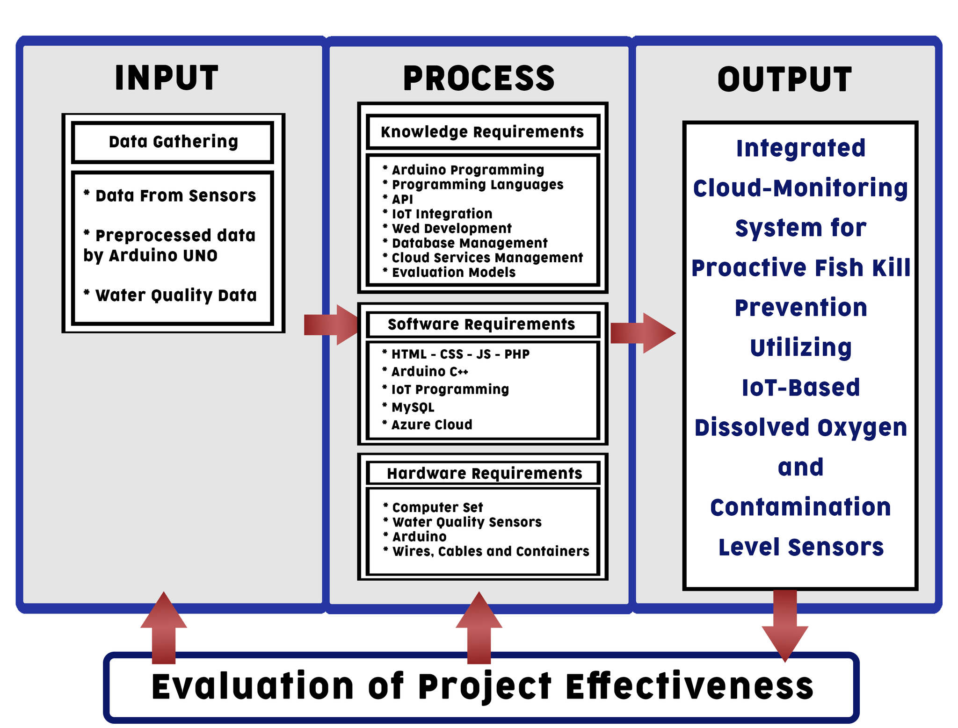
Methodology
Conceptual Framework

Slide 12
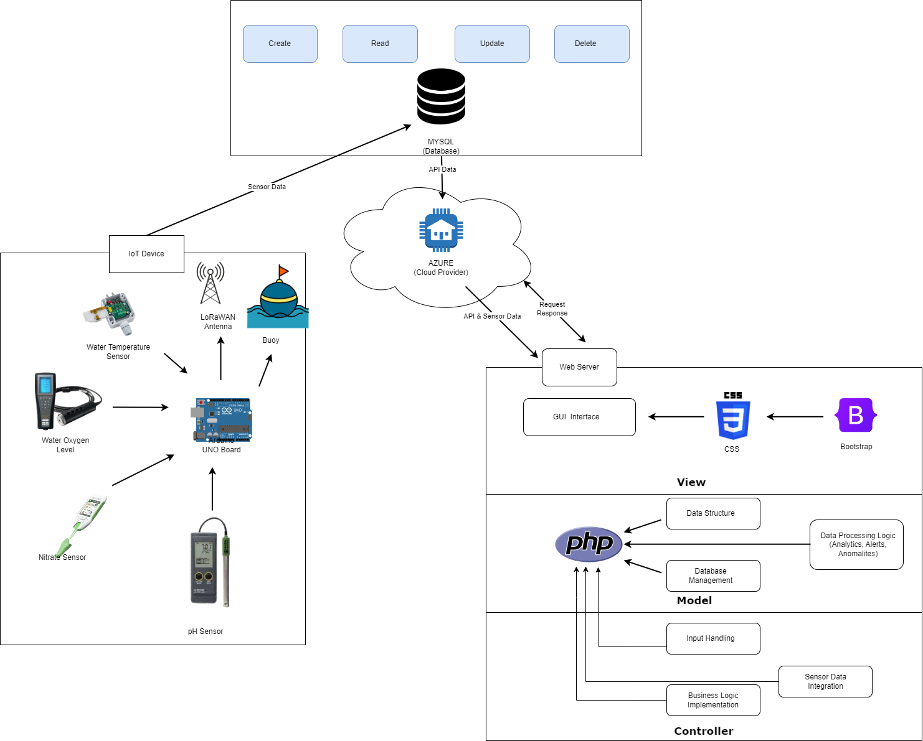
Methodology
System Architecture

Slide 13
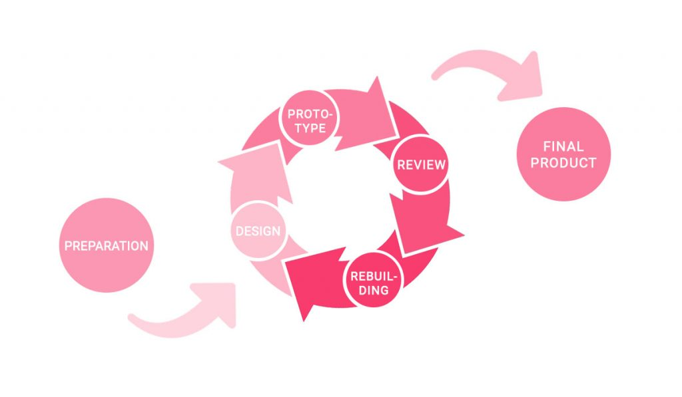
Methodology
Software Development Life Cycle: Prototype Model

Slide 14
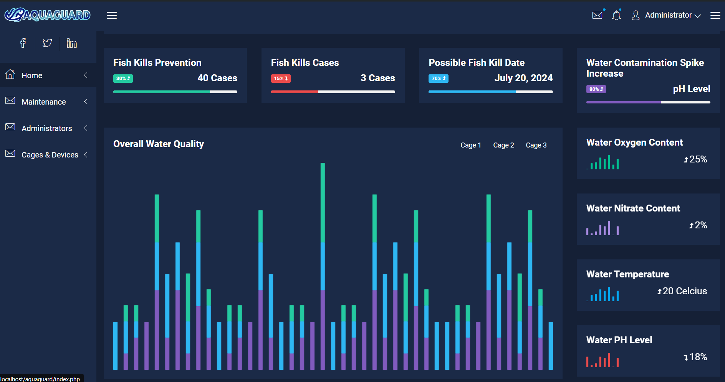
UI/UX Draft Design
Web Interface Design

Slide 15
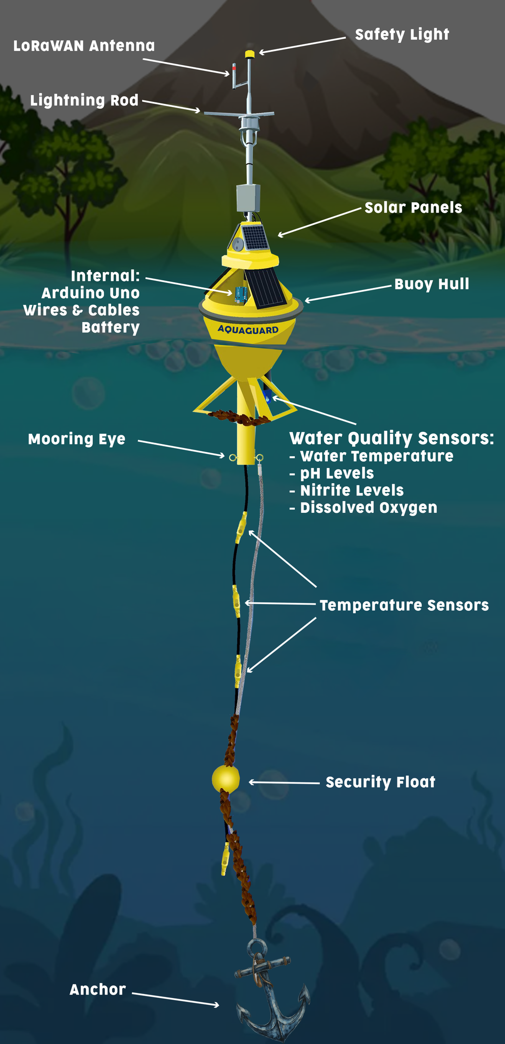
Prototype
Design
Draft Prototype Model

Slide 16
References
Barua, H. B. (2021). Data science and Machine learning in the Clouds: A Perspective for the Future. arXiv (Cornell University). http://arxiv.org/pdf/2109.01661.pdf
Chiu, M., Yan, W., Bhat, S. A., & Huang, N. (2022). Development of smart aquaculture farm management system using IoT and AI-based surrogate models. Journal of Agriculture and Food Research, 9, 100357. https://doi.org/10.1016/j.jafr.2022.100357
Munir, M. S., Bajwa, I. S., Naeem, M. A., & Ramzan, B. (2018). Design and implementation of an IoT system for smart energy consumption and smart irrigation in tunnel farming. Energies (Basel), 11(12), 3427. https://doi.org/10.3390/en11123427
References

Slide 17
References
Mendoza, M. U., Dur, G., Rosana, M. R., Santos, M. D., Mutia, M. T. M., Kawit, N. S., Ite, M. O., Villanueva, L. S., Anneville, O., Souissi, S., & Papa, R. D. S. (n.d.). Water quality and weather trends preceding fish kill occurrences in Lake Taal (Luzon Is., Philippines) and recommendations on its long-term monitoring. Archīum Ateneo. https://archium.ateneo.edu/es-faculty-pubs/39/
Nugroho, L. E., Pratama, A. G. H., Mustika, I. W., & Ferdiana, R. (2017). Development of monitoring system for smart farming using Progressive Web App. 2017 9th International Conference on Information Technology and Electrical Engineering (ICITEE). doi:10.1109/iciteed.2017.8250513

Slide 18
References
Liu, X., Xiang, W., Li, Y., Li, M., & Zhou, J. (2019). IoT-Based monitoring and water environment prediction of river sections. Water, 11(6), 1228. https://doi.org/10.3390/w11061228

